Slide 1
Rainfall Prediction Using Machine Learning
Team Members :​
Arya Gupta​
Ding juncheng
Hteik Tin Min Pang​
Hussain Sakarwala​
Ishaa Budonkayala​
Nong Minh Hieu​
Shivang Singh​
Ye Shenghua

Slide 2
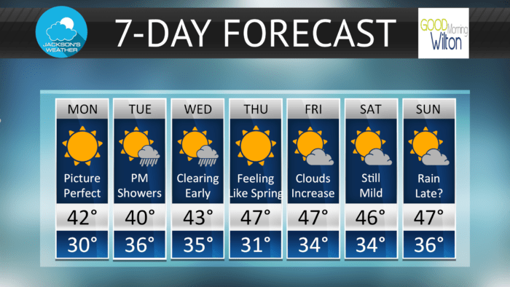
Introduction
Ever wondered if you should carry an umbrella tomorrow?
Every day, weather conditions affect our plans, from choosing our outfits to deciding our travel routes. In Australia, where climate patterns can be especially unpredictable, forecasting rain can be valuable for both individuals and industries alike. Using machine learning, this project predicts if it will rain tomorrow, helping everyone stay prepared.

Slide 3
Data Description (Overview)
Data source (Australian Rain – Kaggle): https://www.kaggle.com/datasets/jsphyg/weather-dataset-rattle-package/data
Records 10 years of daily observations from Australian weather stations across the country.
The target variable is RainTomorrow, which indicates whether rain occurs the following day (Yes – No).

Slide 4
Data Description (Variables)
Variables | Descriptions
Location | Cities in Australia
Rainfall | Amount of rainfall (mm) recorded during the day.
Temperature | Minimum, maximum and temperatures at 9am, 3pm.
Wind | Direction and speed (km/hour) of the strongest wind gust + wind direction and speed recorded at 9am and 3pm.
Cloud | Fraction of sky obscured by clouds at 9am and 3pm.
Sunshine | Number of hours of bright sunshine during the day.
Humidity | Humidity (percentage) recorded at 9am and 3pm.
Pressure | Atmospheric pressure (hpa) recorded at 3am and 3pm.
Rain Today | Whether rain occurs today or not (Yes – No).

Slide 5
Data Preprocessing
We employed two types of models:
Parametric/Distance-based: KNN and Logistic Regression.
Tree-based models:
Decision Tree.
Random Forest.
Ada-boosting Tree.
And we employ two sets of preprocessing steps according to model types:
Parametric/Distance-based | Tree-based
Standardization for numerical features. One-hot encoding for categorical features. | Label encoding for categorical features.

Slide 6
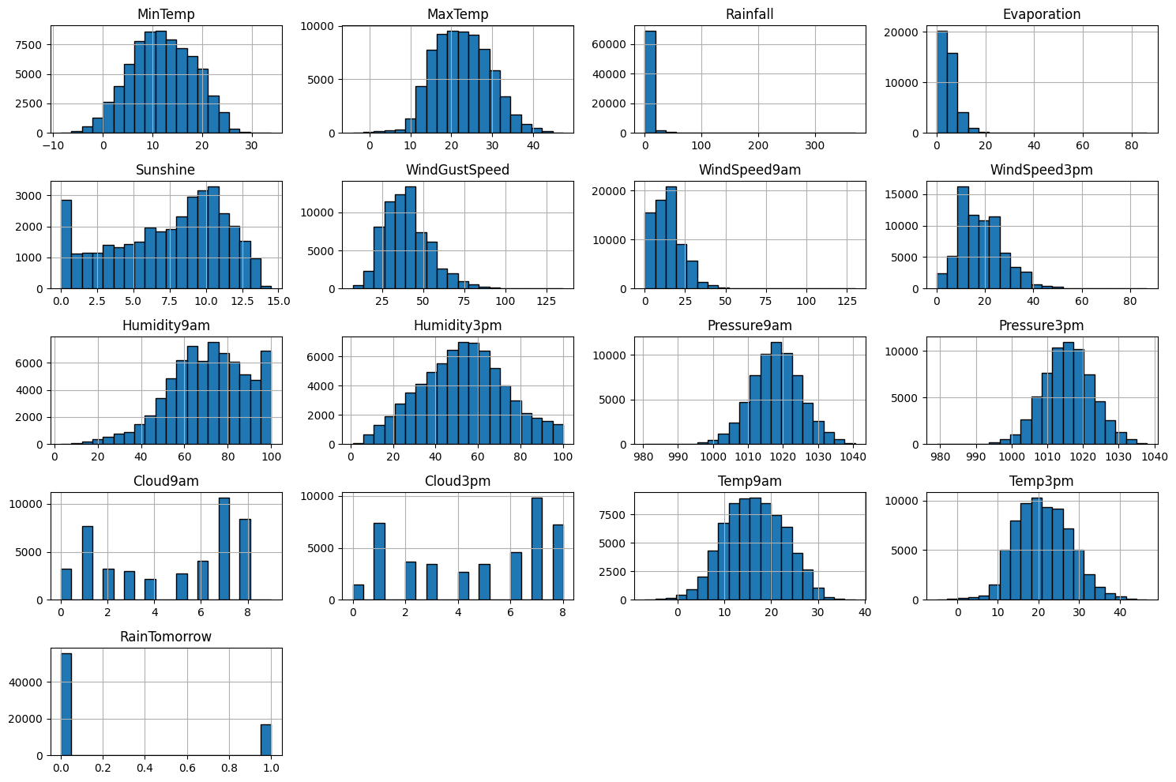
EDA

Slide 7
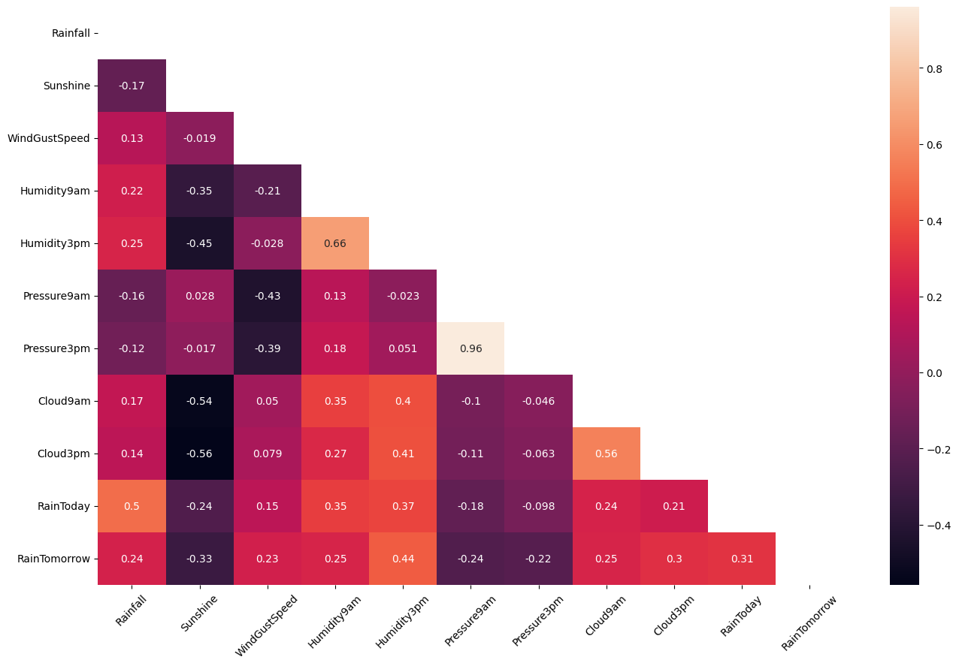
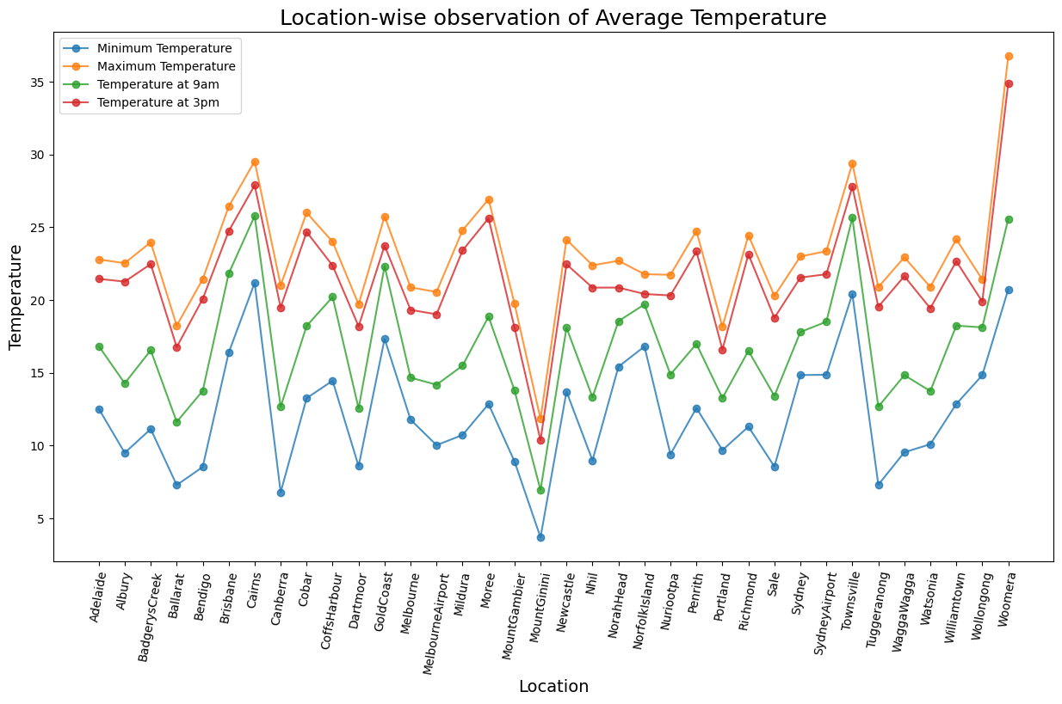
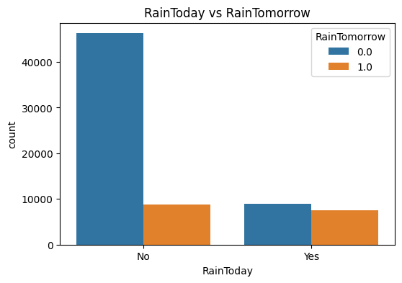
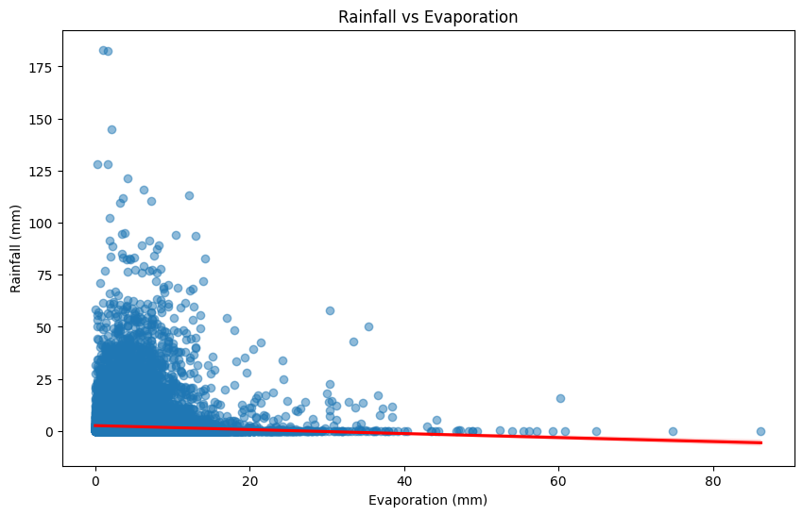

Slide 8
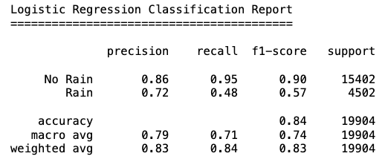
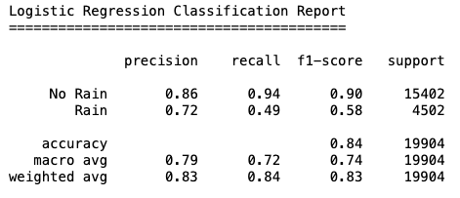
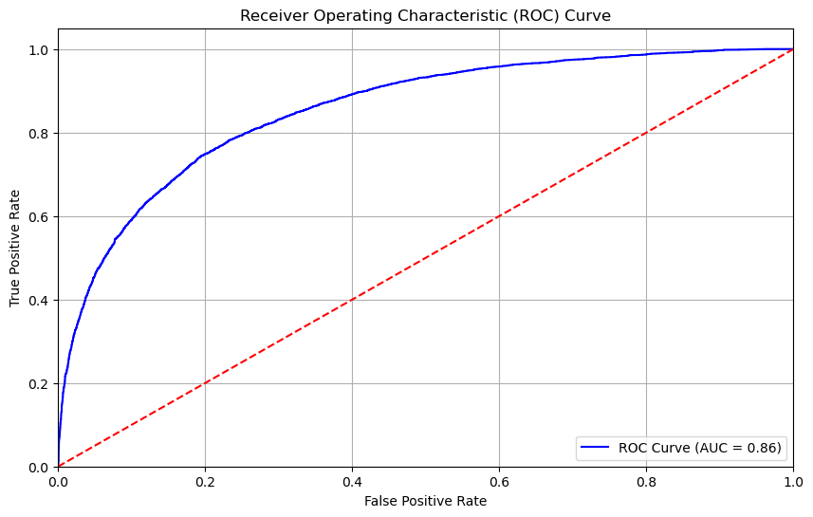
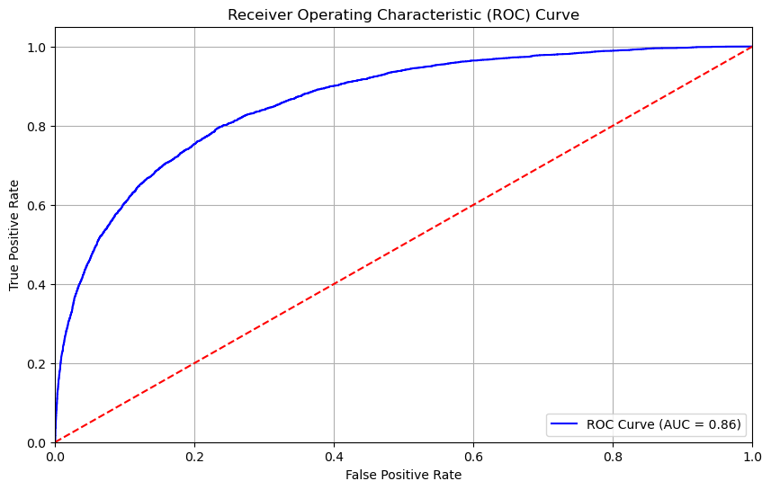
Logistic Regression
Original Dataset
Scaled Dataset
Overall Accuracy – 83.91%
Overall Accuracy – 84.09%
AUC – 0.8552
AUC – 0.8618

Slide 9
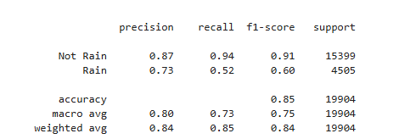
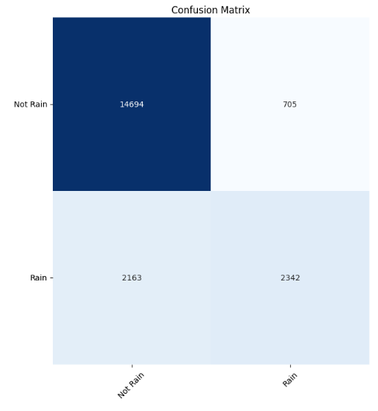
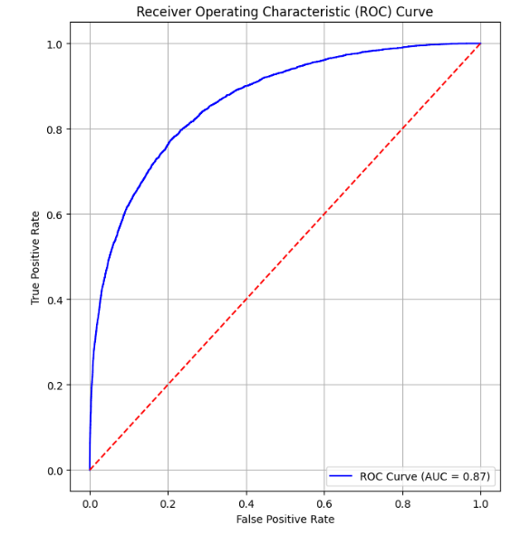
Adaboost
Overall Accuracy – 85.25%
AUC – 0.8661

Slide 10
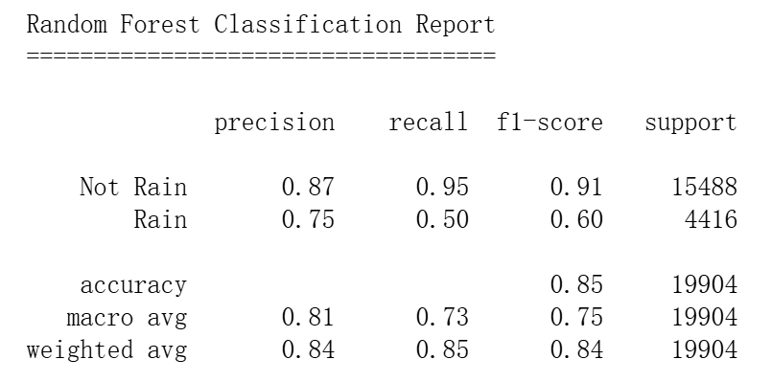
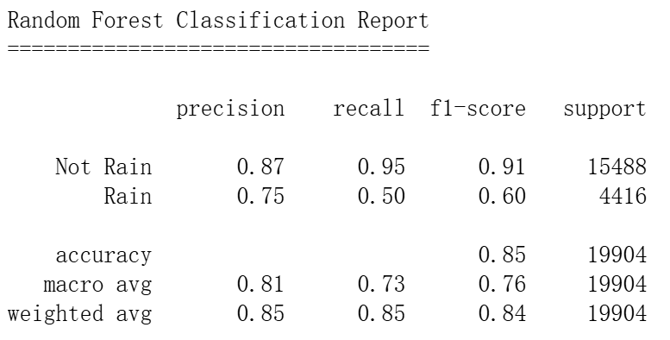
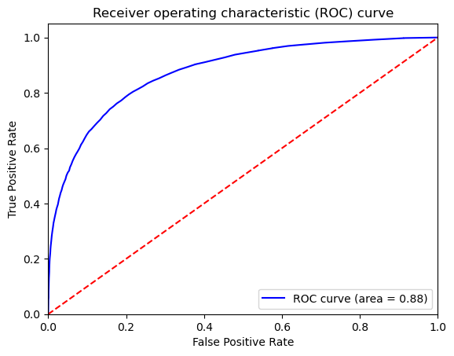
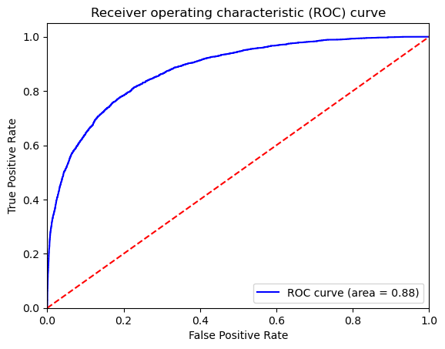
Random Forest
After tunning, best parameters as follows:
bootstrap: True, criterion: gini, max_features: sqrt,
max_depth: 20, min_samples_leaf: 1, min_samples_split: 2, n_estimators: 200
Dataset with features correlation coefficient features > 0.05
Overall Accuracy – 85.24%
Overall Accuracy – 85.36%
AUC – 0.8755
AUC – 0.8780

Slide 11
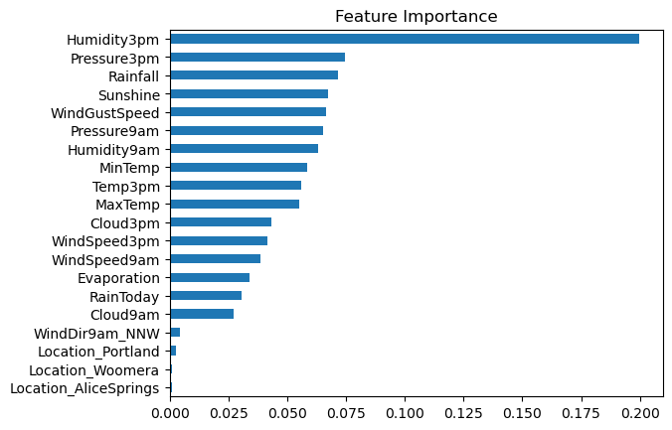
Random Forest
Feautures | Correlation Coefficient | Feature Importance
Humidity3pm | Highest | Highest
Pressure3pm | High | High
Rainfall | High | High
Sunshine | High | High
Pressure9am | High | High
WindGustSpeed | High | High
Humidity9am | High | High
MinTemp | High | High
Temp3pm | Moderate | High
MaxTemp | Moderate | High
Cloud3pm | High | Moderate
WindSpeed3pm | Moderate | Moderate
WindSpeed9am | Moderate | Moderate
Evaporation | Moderate | Moderate
RainToday | High | Moderate
Cloud9am | High | Moderate
WindDir9am_NNW | Low | Low
Location_Portland | Low | Low
Location_Woomera | Low | Low
Location_AliceSprings | Low | Low
For most features, the correlation coefficient and feature importance align, indicating a consistent relationship.
For some features, like MaxTemp and RainToday, the correlation coefficient and feature importance differ. This could be due to non-linear relationships, interactions with other features, or the specific algorithm used to calculate feature importance.

Slide 12
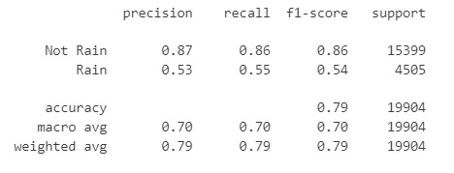
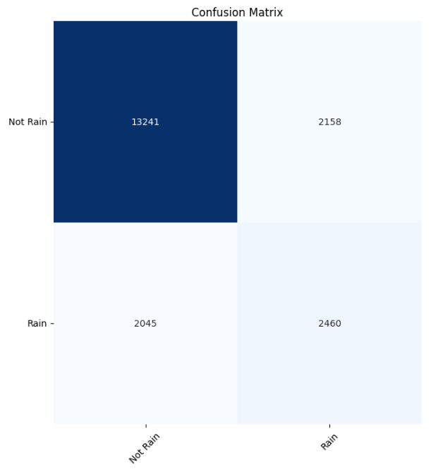
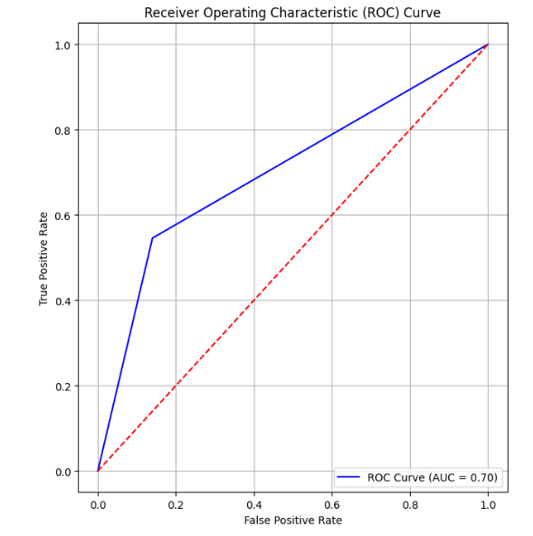
Decision tree
Overall Accuracy – 78.83%
AUC – 0.701
Notes:
The Decision Tree model, with an accuracy of 79%, performs well in predicting non-rainy days but shows moderate performance in identifying rainy conditions. The ROC curve with an AUC of 0.70 indicates room for improvement, suggesting further tuning or feature engineering could enhance rain predictions.

Slide 13
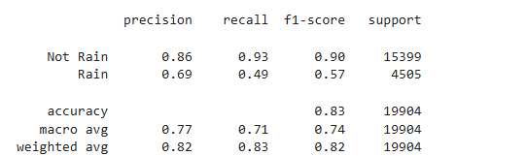
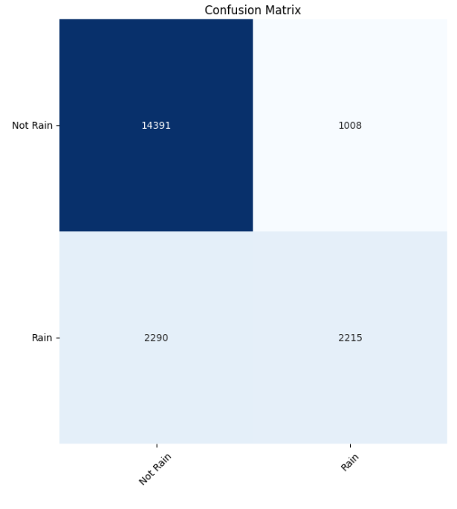
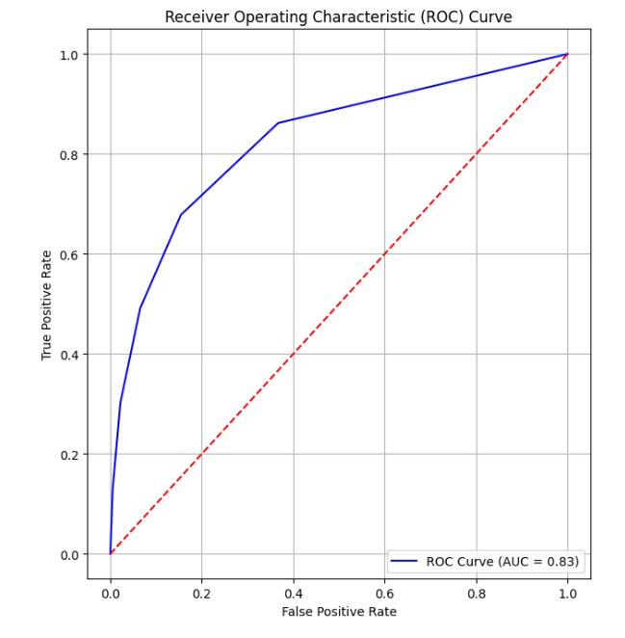
K-Nearest Neighbors (KNN)
Overall Accuracy –83. 31%
AUC – 0.8291
Notes:
The K-Nearest Neighbors (KNN) model achieved 83% accuracy with an AUC of 0.83, excelling in predicting non-rainy days but facing challenges with rain predictions. With high recall for non-rain events (0.93) and moderate recall for rain events (0.49), the model highlights the impact of class imbalance, suggesting the need for further tuning to improve rain classification.The K-Nearest Neighbors (KNN) model achieved 83% accuracy with an AUC of 0.83, excelling in predicting non-rainy days but facing challenges with rain predictions. With high recall for non-rain events (0.93) and moderate recall for rain events (0.49), the model highlights the impact of class imbalance, suggesting the need for further tuning to improve rain classification.

Slide 14
Comparative Analysis of All Models
Model | Accuracy | Precision | Recall | F1 | AUC
Logistic Regression | 84% | 84% | 85% | 84% | 87%
AdaBoost | 85% | 84% | 85% | 84% | 87%
Random Forest | 85% | 85% | 85% | 84% | 88%
Decision Tree | 79% | 79% | 79% | 79% | 70%
KNN | 83% | 82% | 83% | 82% | 83%

Slide 15
Conclusion
Random Forest :
The Random Forest model performs best overall with a 88%AUC and balanced metrics across accuracy, precision, recall, and F1-score. This suggests that it is well-suited for handling the complexities of the dataset and offers a strong balance between sensitivity and specificity .Its higher AUC indicates that it is especially effective at distinguishing between days when it will rain and days when it won't.
AdaBoost and Logistic Regression :
Both AdaBoost and Logistic Regression models also show strong performance, with 87%AUC values close to that of Random Forest .They exhibit similar precision, recall, and F1-scores to Random Forest, indicating that they also balance correctly predicting rain and no rain well.
Decision Tree and KNN:
The Decision Tree model has the lowest performance, particularly in 70%AUC , suggesting it may not generalize as well to unseen data and is more likely to overfit to specific patterns in the training set.KNN shows competitive performance with AUC of 83% but lags behind Random Forest, Logistic Regression, and AdaBoost in recall and precision which may be due to sensitivity to feature scaling or noise.

Slide 16
Recommendation
Ensemble Methods: Random Forest and AdaBoost are well-suited for handling:
Seasonal and geographic variability.
Potential class imbalance in the dataset.
Advantages:
Ensemble methods combine weak learners for increased robustness compared to single models (e.g., Decision Tree).
Enhanced accuracy in predicting rain, allowing for effective planning across sectors.
Impact:
Improved resilience and safety amid Australia’s extreme climate, benefiting industries, public services, and individuals.

